Slide 1
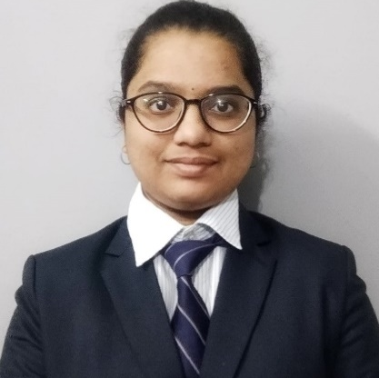
Rutuja Vetal
Bachelor of Engineering, Computer Engineering : 2018-2022
Analyst/Software Engineer
ITransform L&D Left Shift Batch
Skills
C# | Basics, OOPS, Exception Handling ,Arrays ,Collection and Generics, Delegates and Events, File Io and Serialization.
.NET Framework | Architecture which includes CTS,CLS,FCL,BCL and CLR.
Ado.net | Basics Architecture
Database | SQL
Tools | GIT
UI Technology | HTML5 ,CSS & Angular
Add On Skills | Communication Skills
Banglore
rutujavetal@gmail.com
+91 9359885981
A4
Full Stack Developer
Understanding of RDMS concepts using SQL Server.
Practical understanding of C# and SQL concepts using Visual Studio and SQL Server
Hands on experience in developing applications using .NET Framework, ADO.NET Core
Understanding of HTML5 , CSS and Angular Cli
Completed case study on Online Shopping Cart System Using Angular, Asp.net, Microsoft SQL Server. This is the online website where user can buy different products from anywhere and this products will be home delivered. Payment can be possible through card or cash on delivery
.
Technologies used:
ANGULAR
ASP.NET CORE
Microsoft SQL Server
Video Link : Click
GitHub Link: Click

